Slide 1

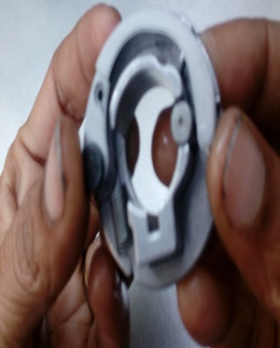
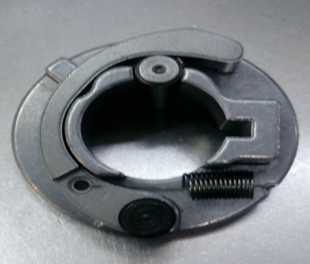
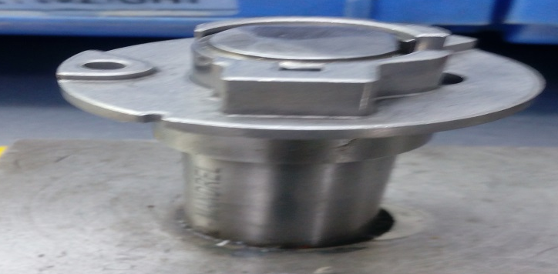
P15
TPM CIRCLE NO :- 01
ACTIVITY
KK
QM
PM
JH
SHE
OT
DM
E&T
KAIZEN IDEA SHEET
TPM CIRCLE NAME:
LOSS NO. / STEP
DEPT :-Assembly
RESULT AREA
P
Q
A
C
D
S
M
CELL:-A362
CELL NAME:-Decomp
MACHINE / STAGE :- Grouping /Riveting
OPERATION :- Grouping
KAIZEN THEME : To eliminate I.D u/s job customer complaint
IDEA :-To provide new mandrel for grouping stages.
Problem present status :- not arrest I.D burr , I.D undersize job on grouping stage
COUNTERMEASURE:-provide mandrel for grouping stage so that I.D undersize or burr job detect at grouping time
BENCHMARK
TARGET
KAIZEN START
25 Nov 2016
TDC
01. Dec 2016
TEAM MEMBERS : Chandani Bansode
,Samadhan bankar ,nitin sutar.
KAIZEN FINISH
01 dec 2016
BENEFITS :-
Quality improvement ,Reduce inhouse rejection .
Before
After
KAIZEN SUSTENANCE
WHY - WHY ANALYSIS :-
Why1 :- I.D undersize job
Why2 : I.D burr job
Why3:- Grouping manually
Why4 :- I.D undersize job not detect
RESULT :- Reduces chances of customer complaint
WHAT TO DO:-.Quality Improve
HOW TO DO:- Mandrel material change
FREQUENCY :- Daily
ROOT CAUSE : Mandrel I.D lower size (Ware out )
REGISTRATION NO. & DATE :-4.12.2016
SCOPE & PLAN FOR HORIZONTAL DEPLOYMENT
REGISTERED BY :- Chandani Bansode
SR.
NO.
CELL
TARGET
RESPONSIBILITY
STATUS
MANAGER’S SIGN :-Janardhan Sathe
1

